Slide 1
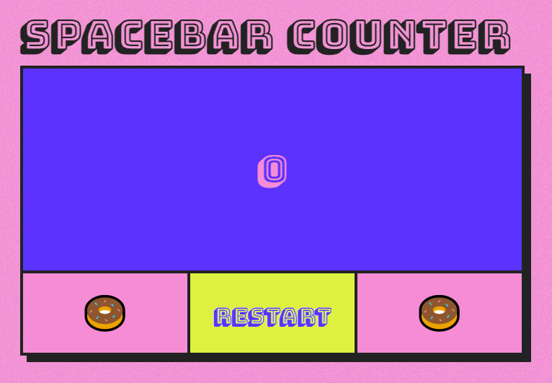
Spacebar Challenge
Click the link above to launch the spacebar challenge site
Set a timer for 30 seconds
Use your phone or your computer timer
Press the spacebar as many times as you can before time runs out
Submit your score

Slide 2
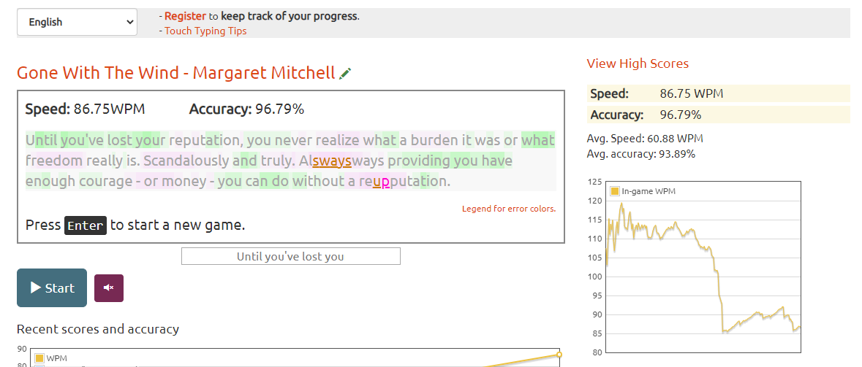
Typing Test
1
2
3
Click the link to go to the typing test webpage
Select the language you prefer for the typing speed test (1)
Press start (2), and the timer will begin when you start typing
If you do not fix mistakes, a penalty will be deducted
Submit your speed (in words per minute - WPM) and accuracy percentage (3)

Slide 3
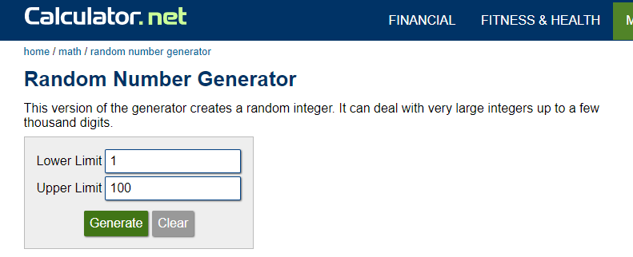
Random Number Challenge
Click the link above to launch the random number generator
Keep the limits at 1-100
Click “Generate” three times and record the number each time
Submit your random numbers and the average
Highest average wins!

Slide 4
GeoGuessr
Click the link above to launch GeoGuessr
Play the Free 5-Round Game of GeoGuessr
Step by step instructions in remaining slides
Trying to guess where you are in the world from a Google Maps Street View
You get more points based on how close your guess is to the real location
You get less points the longer it takes to guess
After playing the 5 rounds, submit your total score and game breakdown

Slide 5
Paper Airplane Toss
Create a paper airplane (you can use any design or type of paper)
Throw the airplane and measure the distance
Submit your furthest distance and share a picture of your airplane

Slide 6
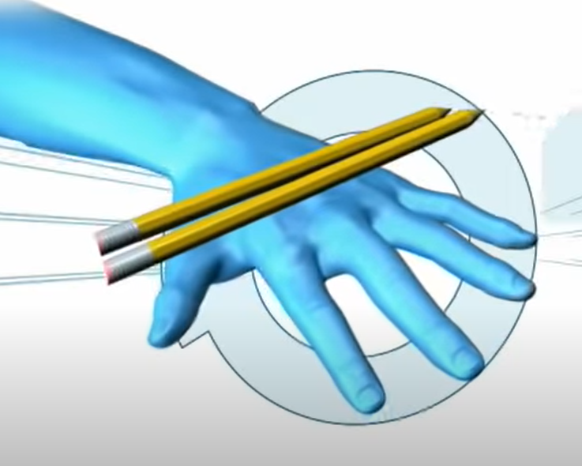
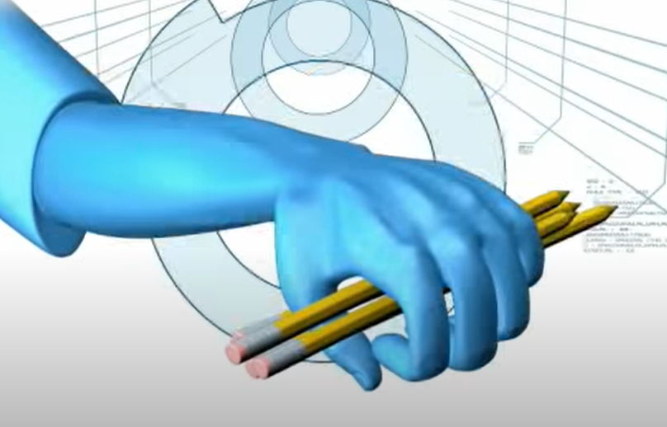
Pencil Catching Challenge
Start with 2 pens or pencils and rest them on the back of your hand
Flip the pencils into the air and catch them with the same hand
Continue to add pens or pencils
Submit the highest number of pens or pencils you could catch at once
Video proof is fun, but optional
Did you know there’s a world record for this?
Alexander Turner caught 53 pencils flipped from the back of his hand

Slide 7
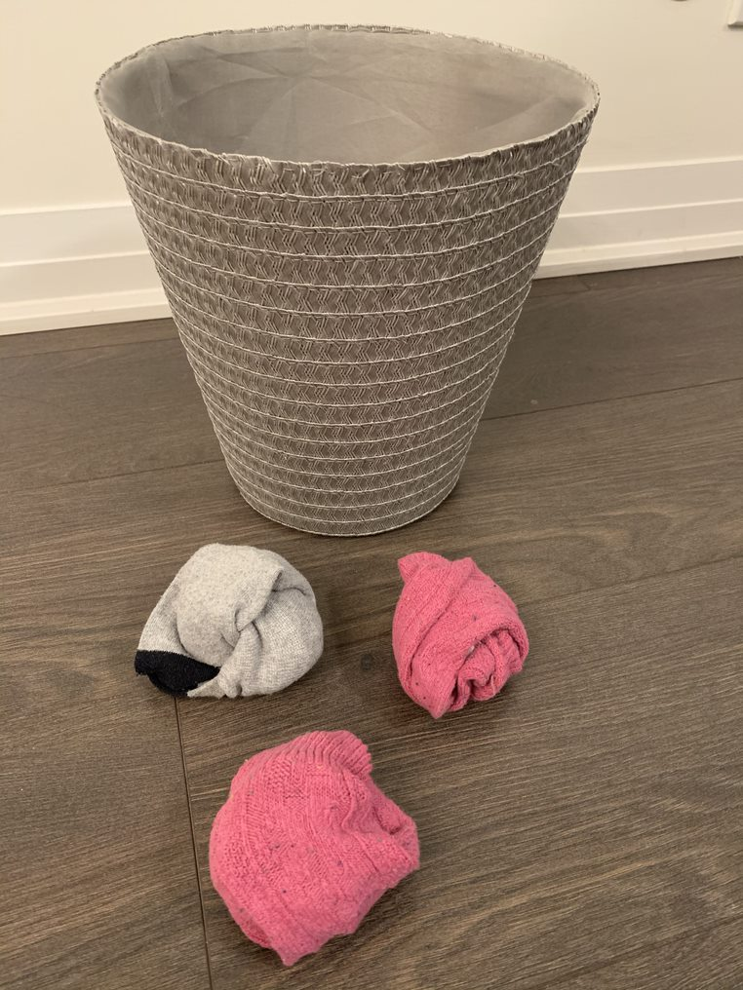
Sock Basketball
Roll up 10 socks into balls
Use a trashcan or empty pot with a diameter of 8-10 inches (20-25 cm) as the basket
Stand 6 feet (1.8 m) away from the basket
Throw the 10 socks in
Submit your score for how many made it in!
Share a picture too!

Slide 8
Sticky Note Challenge
How many sticky notes can you stick to your face in 30 seconds?
Use the standard 3x3 size Post-It Note
Set a timer for 30 seconds
Use your phone or your computer timer
Sticky part must be on your skin and not on another paper
Submit a photo of yourself with all the sticky notes on your face and the total count of sticky notes
Did you know there’s a world record for this?
Taylor Maurer has the record for putting 60 sticky notes on her face in 60 seconds

Slide 9
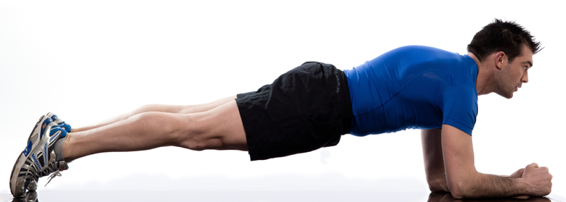
Plank Challenge
Time how long you can stay in plank position (pictured above)
Submit your time (photo or video proof optional)
Did you know there’s a world record for this?
George Woods held himself in plank position for 8 hours and 15 minutes

Slide 10
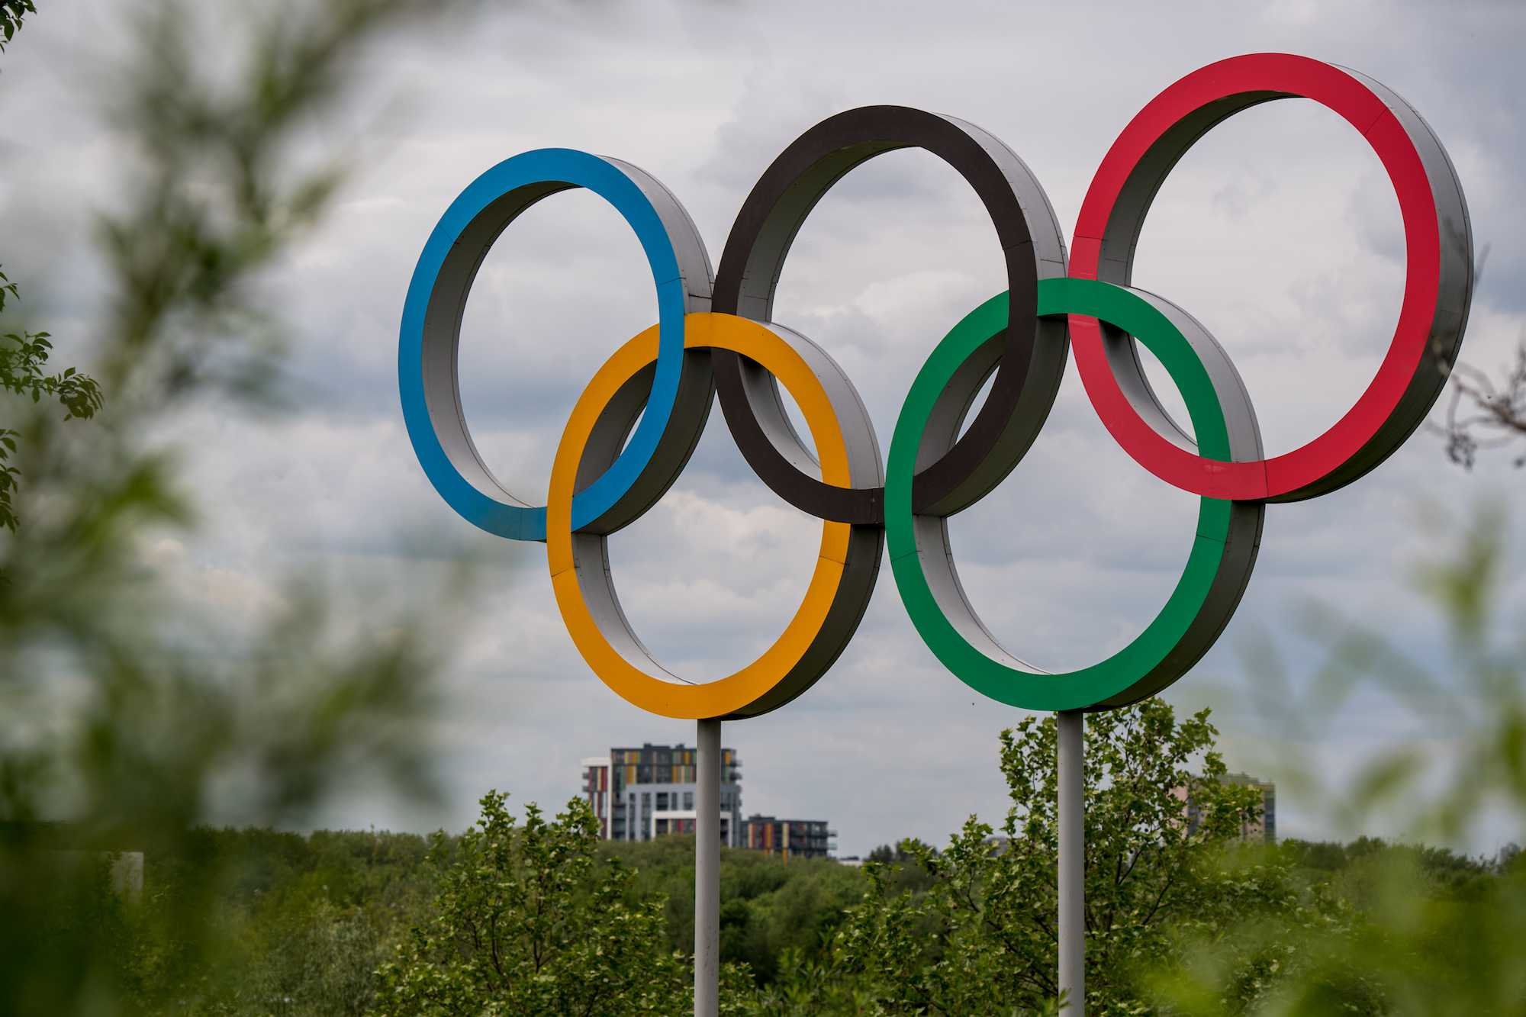
Olympic Rings Design
Using items in your home or office, create the iconic Olympic Rings
The blue, yellow, black, green, and red colors must be identifiable in the design
Submit your photo
The Team will have the opportunity to vote on the best design

Slide 11
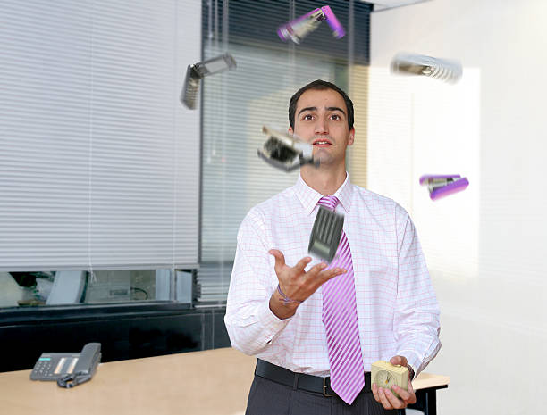
Juggling Office Supplies
Gather some office supplies and see how many you can juggle
Submit a photo or video
Submit a list of objects you were able to juggle
The Team will have the opportunity to vote on the best juggling
Consider using stress balls, balled up paper, rolls of tape, or markers
Stay away from scissors, pushpins, or open cups of coffee

Slide 12
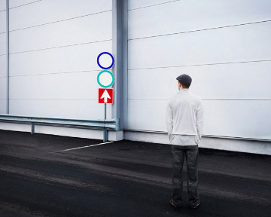
Web Cam Camouflage
Turn on your webcam you use for meetings and turn off any virtual backgrounds
Dress to blend in with your background
Take a web came selfie and submit it
The Team will have the opportunity to vote on the best camouflage

