Slide 1
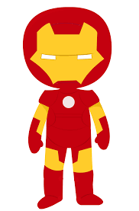
Find Your Superhero Name
First Letter of Your Name
A Captain
B Wonder
C Super
D Phantom
E Dark
F Incredible
G Professor
H Iron
I Hawk
J Turbo
K Steel
L Mighty
M Atomic
N Torch
O Space
P Bolt
Q Archer
R Fantastic
S Invisible
T Night
U Silver
V Aqua
W Amazing
X Giant
Y Power
Z Mega
And Your Birth Month
Jan Shield
Feb Arrow
Mar Justice
Apr Thunder
May Rider
Jun Falcon
Jul Ninja
Aug Spider
Sept Beast
Oct Blade
Nov Hulk
Dec Doom

