Slide 1
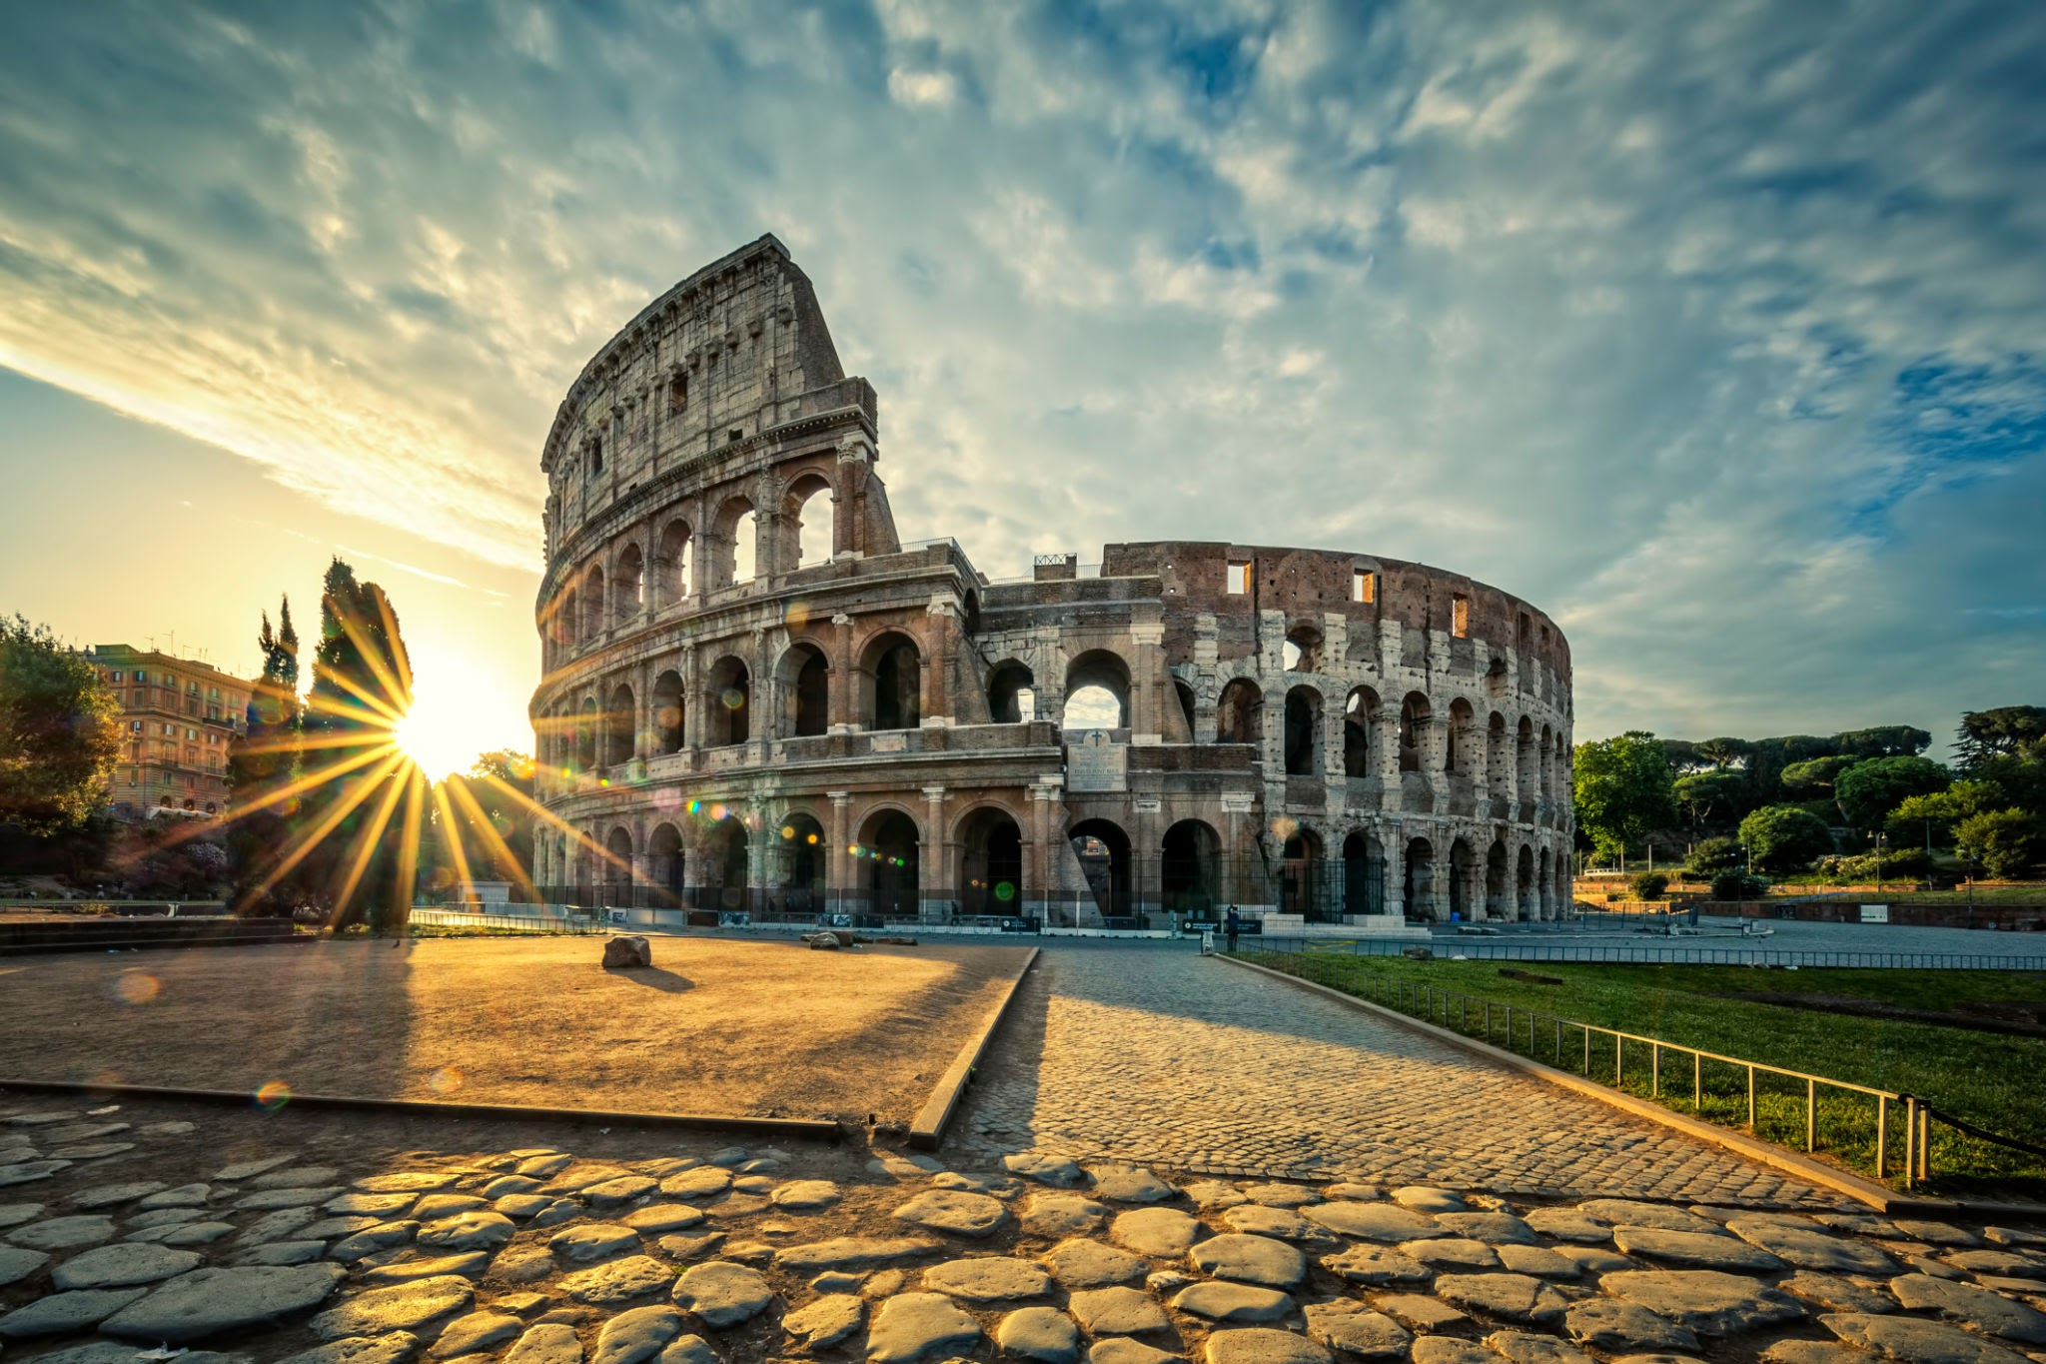
Italian Olympic Challenge
Compete in 5 Events to Win

Slide 2
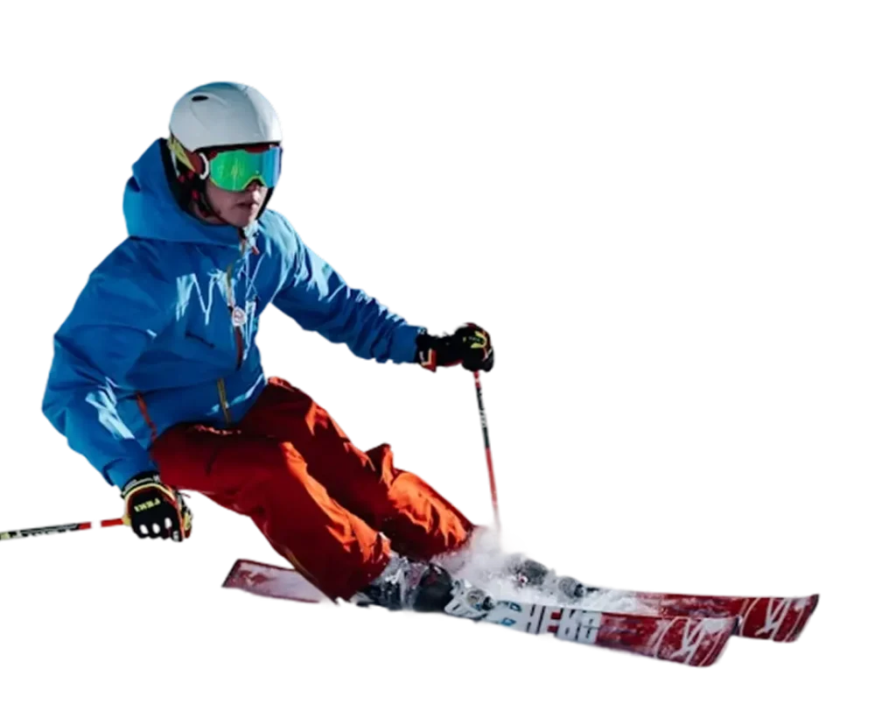
Ski Down the Alps
Using the provided materials, create skis for the skier to race down the slope.
Materials - straws, popsicle sticks, paper, tape
Skier - lego minifigure
Slope - 2-3 inch Binder
Competition
Race the skiers down the slope. Record the order the skiers finish (when the figure reaches the bottom)
1st place = 5 pts
2nd place = 3 pts
3rd place = 1 pt

Slide 3
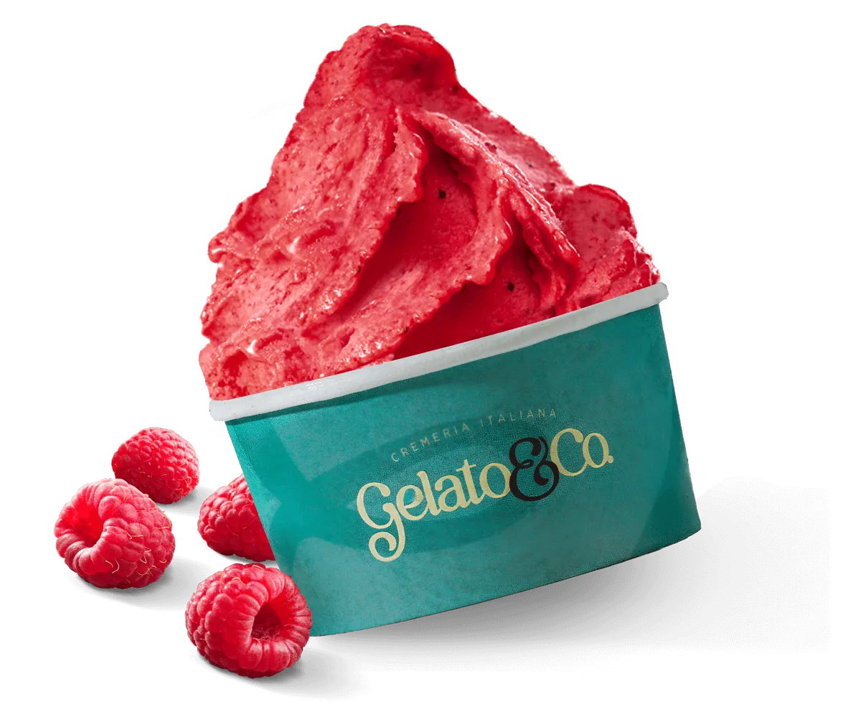
Gelato Race
Scoop gelato into 10 cups!
Materials - 1 gelato spoon/person, 10 paper cups/person, 10 ping pong balls/person
Set Up - 10 empty paper cups are placed 6 ft away from the player.
Competition
Balance a gelato scoop (ping pong ball) on the spoon, walk it down and fill the paper cup. Repeat until all 10 cups are filled - always walking! If a ball drops, pick it up and go back to the start.
Record the order each player completes the 10 cups.
1st place = 5 pts , 2nd place = 3 pts , 3rd place = 1 pt

Slide 4
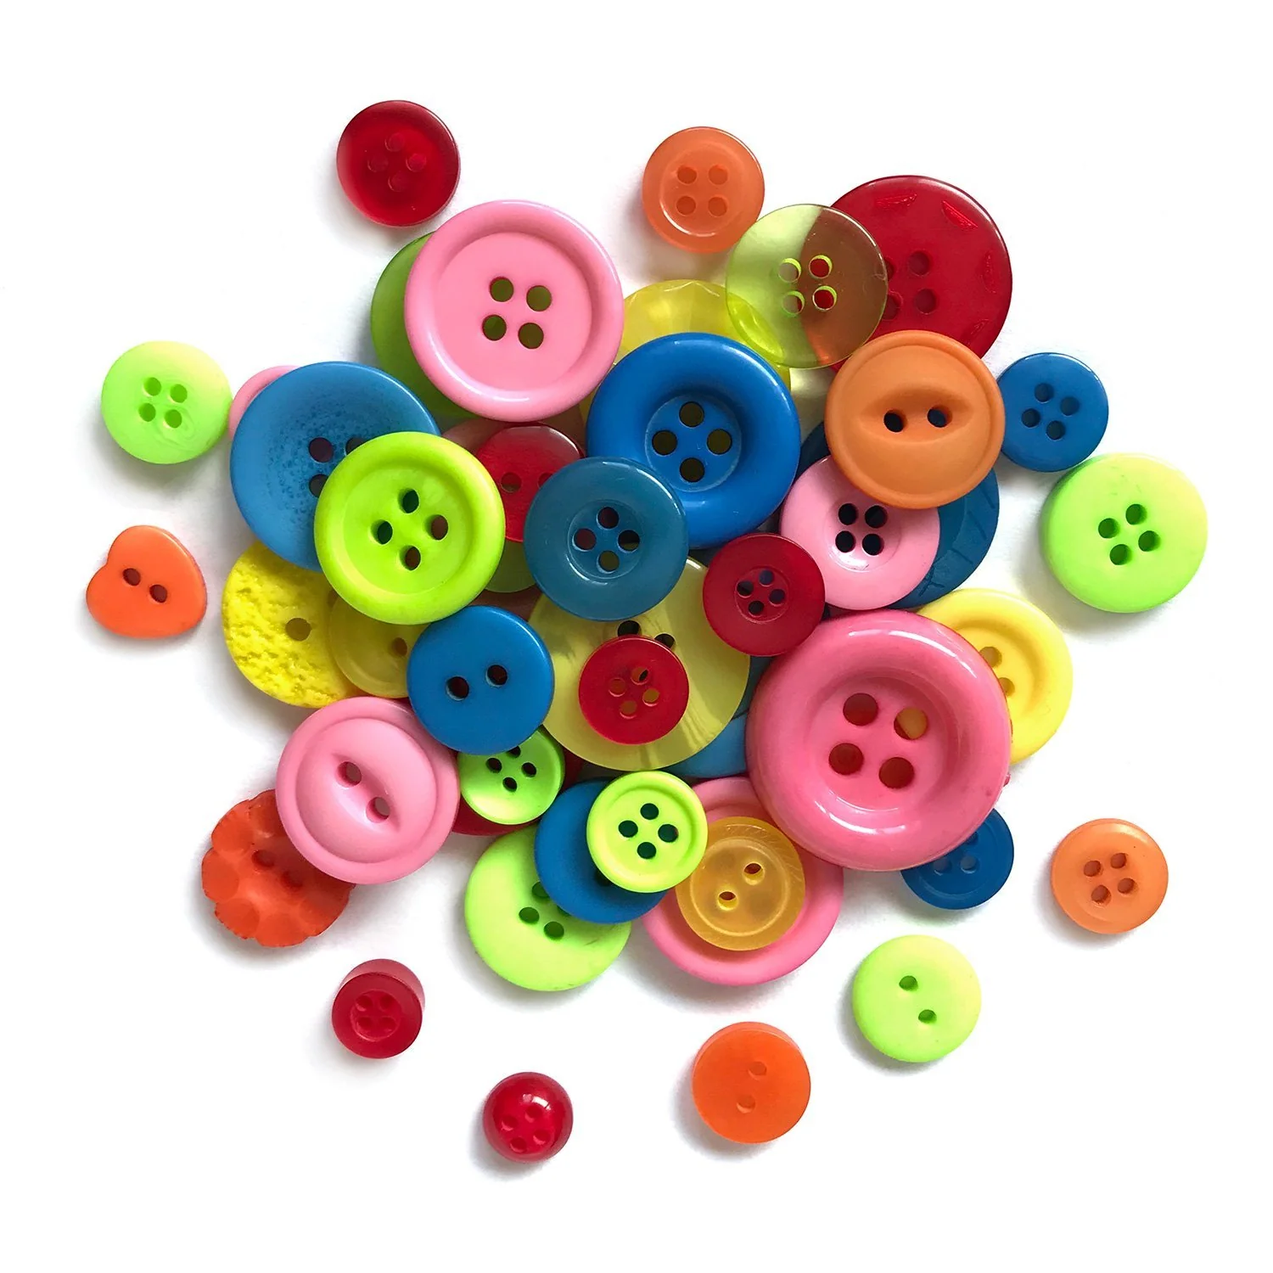
Fashion Button Toss
Score points by tossing buttons into classic fashion items.
Materials - buttons, fashion items (e.g., boots, hat, purses, belts, etc.)
Set Up - line up the fashion items 6 ft away from the players with points per item displayed
Competition
Toss 10 buttons into the fashion items. Total the points earned from each throw. Bonus 5 points if the player gets one button in each item.
Player with the highest total score wins.
1st place = 5 pts , 2nd place = 3 pts , 3rd place = 1 pt

Slide 5
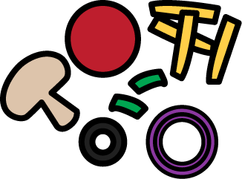
Pizza Topping Race
Be the first to get your pizza ready with all the toppings!
Materials - construction paper pizza crusts and 5 different toppings, dice
Set Up - label dice with 5 toppings and a “lose a turn” side. Each player starts with a pizza dough crust.
Competition
Take turns rolling the dice and add the ingredient shown to your pizza. If you get a repeat topping, add a bit more or just pass to the next person.
Player who completes the pizza with all five toppings wins. Remaining players continue until there is a 1st, 2nd, 3rd place
1st place = 5 pts , 2nd place = 3 pts , 3rd place = 1 pt

Slide 6
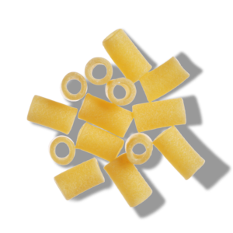
Use Your Noodle
There are more than 300 pasta noodle shapes… don’t worry, you don’t have to learn them all!
Materials - cut out clues for each player, short cut pasta for each type used in the clues
Set Up - In a large bowl, mix all the pasta noodles together (many of each kind) and place the bowl far away from the player. Each player has a stack of the same clues
Competition
Players read their clues, go to the bowl and pick a noodle they think matches the clue. Bring the clue and noodle to the judge. If it’s correct, move to the next clue. If it’s wrong, go back and try another noodle.
Player who completes all their clues first wins.
1st place = 5 pts , 2nd place = 3 pts , 3rd place = 1 pt

